Slide 1

C# Basics

Slide 2
Introduction to C# and .NET
C# is designed by Anders Hejlsberg from Microsoft in 2000
C# is general purpose programming language
C# is object oriented (class-based) programming language
C# is used on .NET platform /.NET 6 is the latest version/
C# can be used for writing of Console, Desktop, Widows Services, Web apps, Mobile apps, Games and IoT
C# supports static typing, functional programming, generics and more features
C# and Microsoft documentation are generally quite good
C# documentation: https://docs.microsoft.com/en-us/dotnet/csharp/

Slide 3

Anders Hejlsberg
Danish software engineer who co-designed several programming languages and development tools. He is the original author of Turbo Pascal and co-chief of Delphi. Currently works in Microsoft as a lead architect and core developer of TypeScript.

Slide 4
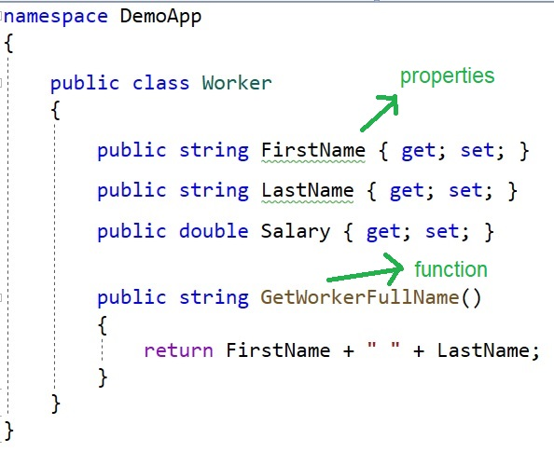
C# is object oriented programming language

Slide 5
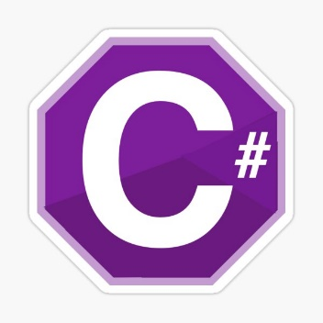


What is .NET?
.NET is a free, cross-platform, open source developer platform for building many different types of applications.
With .NET, you can use multiple languages, editors, and libraries to build for web, mobile, desktop, games, and IoT.
The two main components of .NET are CoreCLR and CoreFX
You can write on C#, F#, Visual Basic and other programming languages.

Slide 6

.NET = The Ecosystem
Languages
Runtimes
Libraries

Slide 7
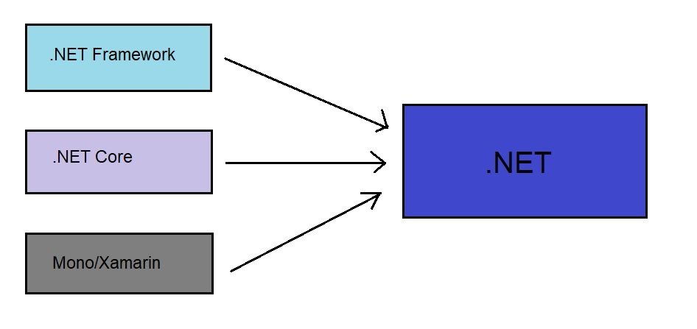
.NET ecosystem

Slide 8
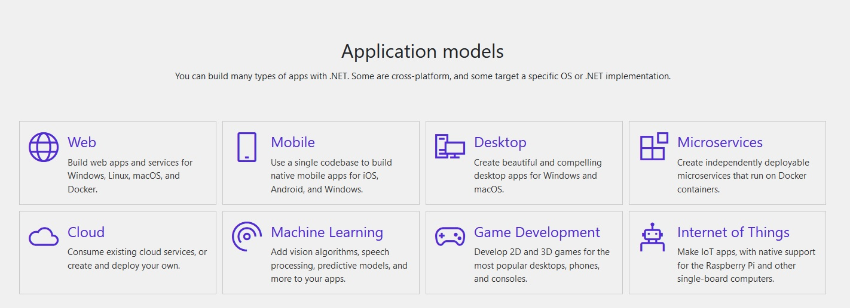
.NET platform /whole new world/

Slide 9
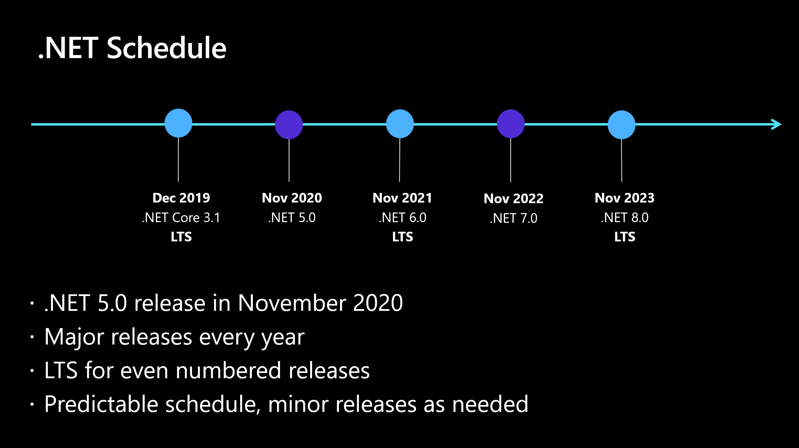
.NET Schedule

Slide 10
What is compiler?
A compiler is a special program that translates a programming language's source code into machine code, bytecode or another programming language. The source code is typically written in a high-level, human-readable language such as C#, Java, C++, etc.

Slide 11
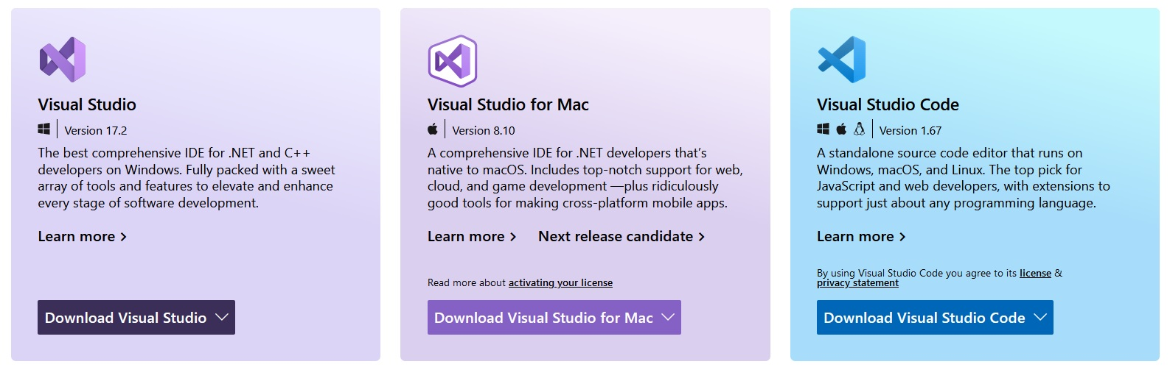
What is an IDE?
IDE - Integrated Development Environment is software that helps us to write/debug/run our source more easily and to create our final programs in better way.
An IDE typically consists of:
Source Code Editor
Local Build Automation
Debugger

Slide 12

Visual Studio 2022 /installation/

Slide 13
C# variables
Variables are containers for storing of data values.
In C#, there are different types of variables (defined with different keywords), for example:
Int – stores integers (whole numbers), without decimals, such 127 or -127
double – stores floating point numbers, with decimals, such 19.99 or -19.99
char – stores single characters, such as ‘a’ or ‘B’. Char values are surrounded by single quotes.
string – stores text, such “Hello World”. String values are surrounded by double quotes.
bool – stores values with two states: true or false

Slide 14
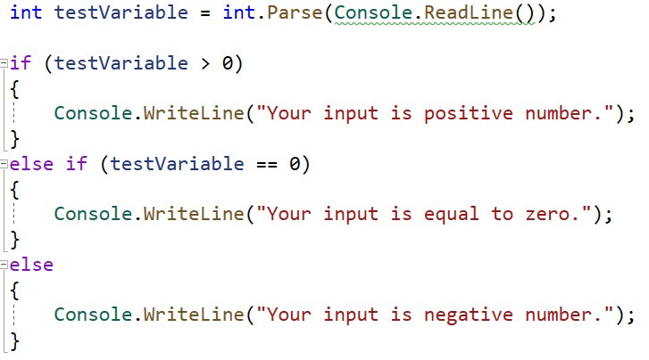
Conditional logic (if/else if/else)

Slide 15
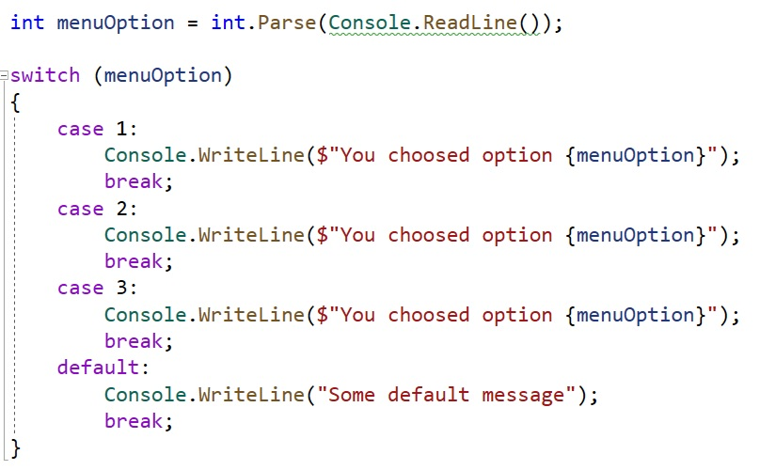
switch/case logic

Slide 16
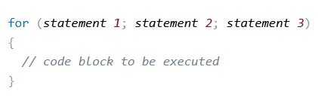
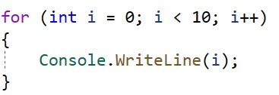
Loops (for loop)
For loop is one of the most used loops in the programming.
It contains three parts:
statement 1 is executed (one time) before the execution of the code block.
statement 2 defines the condition for executing the code block.
statement 3 is executed (every time) after the code block has been executed.

Slide 17
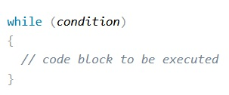
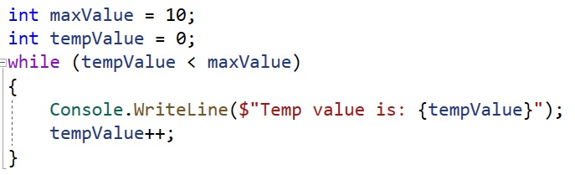
Loops (while loop)
The while loop loops through a block of code as long as a specified condition is True.

Slide 18
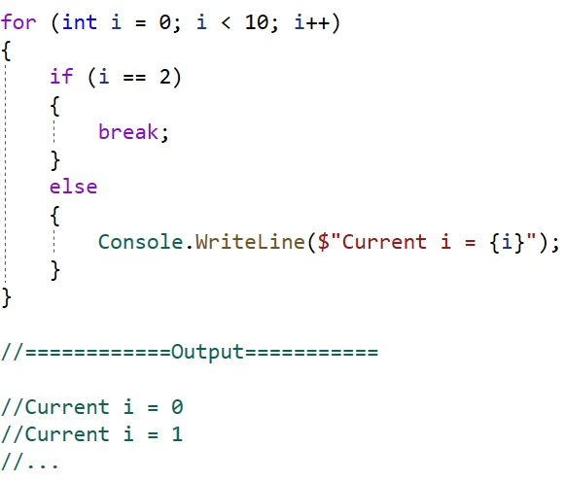
Using of “break”
Break terminates the loop if condition is satisfied.

